Slide 1
“Techniques for Testing Packaged Application Performance”
Michel Feaster, Director of Products, Mercury

Slide 2
Agenda
From LoadRunner to Performance Center
When do you Measure Performance?
Building a Workload Model
Release Criteria and Planning
Load Testing Execution and Analysis
Organizational Structure drives Outcome

Slide 3







Mercury LoadRunner
Performance Monitors
LoadRunner
Controller
User
Simulation
Internet/
WAN
Web
Server
Application
Server
Database
Replaces real users with thousands of virtual users
Generates consistent, measurable, and repeatable load, managed from a single point of control
Efficiently isolates performance bottlenecks across all tiers/layers with automated reporting and analyses

Slide 4
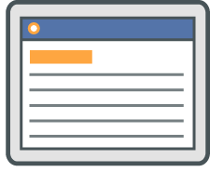




Performance Center-
Best-of-breed Capability Delivered Globally
Application A
A
B
C
Application B
View projects from different locations
Simultaneous browser-based testing of one
or more projects
Receive test data and analyze results
Application C
USA
Pooled
Testing Resources
Europe
Asia
Web Server
CUSTOMER’S CENTRALIZED TESTING ENVIRONMENT
Notes:
People and process are the first two components to ensuring effective delivery. The final component is the right product.
Mercury is the only solution provider that is recognized not just for delivering best of breed solutions for application delivery, but also as a provider that delivers solutions for the changing enterprise.
As companies become more global in their delivery process, Mercury provides a global model using our Mercury Quality and Performance Centers.
A customer who has Mercury Performance Center installed in New York, for example, can have its project teams in Singapore or London or India use the same foundation and applications to test applications around the clock. Working practices and optimized using our Application Delivery offering.

Slide 5
When do you Measure Performance?
Envisioning
Planning
Designing & Developing
Stabilizing
Transfer to Production
Prototyping / Proof of Concept / Technology Evaluation
IronMan Performance Test
Unit Level Perf. Test
User Acceptance Test
Functional Test
Unit Tests
Unit Level Perf. Test
System Integration Test
Notes:
In re-architecture of PC, we

Slide 6
How do you model the workload?
Workload Modeling requires:
  Proactive Monitoring
    Monitor user and system activity in production
    Monitor user and system performance in production
  Proactive Alerting
    Identify failure symptoms
      > 6 sec response times
      Application Errors and Exceptions
      System crash
  Capture Multiple Scenarios
    Improves coverage and accuracy of simulations

Slide 7
Workload Characterization
Tasks
  Define Key Transactions
    Transaction Definition, Volume, and Concurrency
    80-20 Rule for Transaction Selection
  Define Business Processes (based on Transactions)
    Map Transactions to Business Processes
  Define Business Process Distribution
    Approximate Distribution to Match Workload
  Define Load Ramp-up Behavior
    Assess User Load Concurrency Changes Over Time
Workload
Characterization
Workload
Validation
Workload
Calibration

Slide 8





Workload Characterization
Strategy
  Multi-Tier Activity Profiling
    Web Layer
    Application Layer
    Database Layer
  Monitoring
    Activity (request type, concurrency, and rate)
    Performance (CPU, Memory, I/O, Processes, Queuing)
End Users
Internet/
WAN
Web Server
App. Server
Database

Slide 9
Monitoring Timeframe Guidelines
Selection Criteria
  Poor End-User Experience
  High Load Conditions
  Choose Best Samples
Monitoring Options
  Business Availability Center
  3rd Party Monitors
  Web Monitors and Logs
Traffic
Volume
CRASH
!
Time
Activity A
End-User
Performance
Activity B
Time
Timeframes:
T1
T2
T3
T4
T5

Slide 10
Web Profiling Strategies
Types of Web Applications
  Session Agnostic
  Session Based
Monitoring Requirements
  URL breakdown
  Performance per URL
HTTP://...
HTTP://...
HTTP://...
Statistics Over Timeframe T#
Rank | URL Addresses or Expressions | # Hits | % Hits | S.R.T.
1 | http://ebiz/product/specs.aspx?* | 20543 | 11% | 5.87 sec
2 | http://ebiz/product/search.aspx?q=* | 13056 | 6.9% | 8.23 sec
3 | http://ebiz/ | 11024 | 5.9% | 2.45 sec
… | … | … | … | …
Statistics Over Timeframe T#
Top URL Ranking
URL Expressions
Server Response Time

Slide 11
URL Breakdown Strategy (1)
Processing Web Requests
  Filter out non-essential static page requests (eg. gifs, css, js, …)
  Group like operational requests together using expressions
    Express query strings using regular expressions
    Collect query strings for data-driving requests during replay
    For environments where operation is defined by HTTP request body and URL address or query string is insufficient…
      Use any additional web application specific logs
      Use logs and stats from application and database tiers
http://ebiz/products/specs.aspx?prod=electronic&name=camera...
http://ebiz/products/specs.aspx?prod=electronic&name=stereo...
http://ebiz/products/specs.aspx?*
http://ebiz/commerce/online.aspx?op=browse&prd=10436...
http://ebiz/commerce/online.aspx?op=browse&prd=15982...
http://ebiz/commerce/online.aspx
?op=browse&*
http://ebiz/enterprise/search.aspx?query=servers...
http://ebiz/small-business/search.aspx?query=network...
http://ebiz/*/search.aspx?*

Slide 12
URL Breakdown Strategy (2)
Generating Web Statistics
  URL Expression – URL Address or Expression
  # Hits – Number of hits
  % Hits – Percentage of total hits on server
  Rank Hits – Rank based on # Hits
  Total SRT – Total server-side response time (for all hits for url expression)
  % Total RT – Percentage of total server-side response time on server
  Rank SRT – Rank based on Total SRT
  Average SRT – Average server-side response time (color-coded: good / warning / alert)
Hit Statistics
Response Time Statistics
# | URL Expression | # Hits | % Hits | Rank Hits | Total SRT | % Total SRT | Rank SRT | Avg SRT
1 | http://ebiz/product/specs.aspx?* | 20543 | 11 % | 1 | 120587.41 | 6 % | 2 | 5.87 sec
2 | http://ebiz/product/search.aspx?q=* | 13056 | 6.9 % | 2 | 107450.88 | 5.34 % | 4 | 8.23 sec
3 | http://ebiz/ | 11024 | 5.9 % | 3 | 27008.8 | 1.30 % | 47 | 2.45 sec
… | … | … | … | … | … | … | … | …
Statistics Over Timeframe T#

Slide 13
Tools for URL Breakdown
Manual Solutions
  Web Logs
    Manual Processing
    Time Consuming
    Delays base-lining and optimization efforts
Automations
  Mercury Real User Monitor (RUM)
    Non-Intrusive
    URL Expressions
    URL Frequency (Hits)
    URL Performance (SRT)
    Frequency and Performance Correlation
    Integrated into Business Availability Center
  WebTrends
    Integrated into Web Application
    URL Frequency (Hits)
  Others…

Slide 14
Web Modeling – Session Agnostic
Workload Definition Scope
  Top 80+% of URLs based on Hits
  Top 80+% of URLs based on Total Server Response Time
Designing Business Processes
  Group URLs based on Business Operation
    Search, Browse, …
  Create Business Process Scripts
    Insert URLs based on Business Operation
    Insert URLs based on relative ratios
    Define Data-Driven Parameters
      Based on data in web logs
      Based on data source
      Define data probability based on data in web logs

Slide 15
Web Modeling – Session Based
Workload Definition Scope
  Top 80+% of URLs based on Hits
  Top 80+% of URLs based on Total Server Response Time
Designing Business Processes
  Identify Transactions
  Define Transactions
  Calculate Transaction Statistics
  Compute Transaction Distribution

Slide 16
Identify and Define Transactions
Use URL expressions to identify user activity
Map all transactions based on Top URL expressions
http://ebiz/commerce/online.aspx
?op=submit-order&*
Order Transaction
http://ebiz/commerce/online.aspx
?op=confirm&*
Login
Order
Search
Update Account
Home
Add To Cart
Browse
Lookup Account

Slide 17
Compute Transaction Statistics
Transform URL Statistics:
To Transaction Statistics:
# | Transaction Name | Trans Step | URL Expression | # Hits | … | … | … | Avg SRT
1 | Home | 1 | http://ebiz/ | 11024 | … | … | … | 2.45 sec
2 | Order | 1 | http://ebiz/commerce/online.aspx ?op=submit-order&* | 5460 | … | … | … | 10.76
 |  | 2 | http://ebiz/commerce/online.aspx ?op=confirm&* | 4460 | … | … | … | 12.34
… | … | … | … | … | … | … | … | …
# | Transaction Name | Hits Min | Hits Max | Completed Transactions | % of Total Hits (Max) | Total SRT
1 | Home | 11024 | 11024 | 11024 | 11.7 % | 2.45 sec
2 | Order | 4460 | 5460 | 4460 | 5.8 % | 23.10 sec
3 | Login | 8065 | 8065 | 8065 | 8.6% | 3.58
… | … | … | … | … | … | … | … | …
Statistics Over Timeframe T#

Slide 18
Understanding Transaction Statistics
Transaction Metrics
  Hits (Min)
    Hits for the URL with the lowest # of hits for transaction.
  Hits (Max)
    Hits for URL with highest # of hits for transaction.
    Indicates the potential volume of transactions if users completed transaction.
  Completed Transactions
    Equivalent to Min Hits, or Hits for the last URL in the transaction sequence.
  % of Total Hits
    % of hits based on transaction’s ‘Hits (Max)’ value and sum of all transaction’s ‘Hits (Max)’ value
# | Transaction Name | Hits (Min) | Hits (Max) | Completed Transactions | % of Total Hits (Max) | Total SRT
1 | Home | 11024 | 11024 | 11024 | 11.7 % | 2.45 sec
2 | Order | 4460 | 5460 | 4460 | 5.8 % | 23.10 sec
3 | Login | 8065 | 8065 | 8065 | 8.6% | 3.58
… | … | … | … | … | … | … | … | …

Slide 19

Defining Business Processes
Understanding Business Users
  Leverage Business Analysts to map transactions to business processes
  Leverage Web Session Logs to map transactions to business processes (if needed)
  Examples:
    BP 1 = Home – Browse
    BP 2 = Home – Search
    BP 3 = Home – Login – Add To Cart – Order – Logout
    BP 4 = Home – Browse – Login – Add To Cart * K – Order – Logout

Slide 20
Business Process Distribution
Computing Distribution
  Based on Transaction Distribution (% of Total Hits)
  Based on Business Process Makeup
Computational Strategy:
    Best Effort Approximation -- Simple
    Matrix Calculation (beyond scope) -- Complex
Business Process | Percentage
BP 1 – Light Browser | 45%
BP 2 – Searching User | 40%
BP3 – Home Shopper | 5%
BP4 – Industrial Shopper | 10%
Total | 100%

Slide 21
Business Process Sizing
Total Virtual User Load
  Session Agnostic Application
    Peak Concurrent Connections (N)
      Total Users = ~N / 2
    Peak Request Rate
      Defines the rate of requests (ie. pacing)
  Session Based Application
    Peak Concurrent Sessions (M)
      Total Users = ~ M
    Peak Request Rate
      Defines the rate of requests (ie. pacing)

Slide 22
Business Process Ramp-up
Ramp-up rate
  Session Agnostic Application
    Peak Concurrent Connections (N)
      Ramp-up Rate = (~N / 2) Users / K Steps
      Ramp-up Time per Step = (Ramp-up Duration) / K Steps
  Session Based Application
    Peak Concurrent Sessions (M)
      Total Users = (~ M) Users / K Steps
Emulated Load
User
Load
Actual Load
Time
Peak Load Duration
Rampup Duration
Ramp-down Duration

Slide 23
Business Process Ramp-up (2)
Emulated Load
User
Load
Actual Load
Time
Peak Load Duration
Rampup Duration
Ramp-down Duration
User
Load
Actual Load
Time
Peak Load Duration
Rampup Duration
Ramp-down Duration

Slide 24
Modeling through Other Layers
Application Server
  Application Specific Logging
Database
  SQL-level Tracing & Profiling
Limitations
  Difficult to extrapolate to end-user actions
  Does not represent activity terminated at above tiers
  Unreliable/Inaccurate for modeling end-user
  Good for Silo testing only
End Users
Internet/
WAN
Web Server
App. Server
Database

Slide 25
Workload Validation
Tasks
  Validate workload at multiple levels
  Validate End-User Activity
      Is system experiencing similar volume of traffic (ie. reqs/sec)?
      Is system experiencing similar distribution of requests (based on URL expressions)?
  Validate Resource Utilization
      Is system experiencing similar performance behavior on each tier?
      CPU, Memory, Processes, Queuing
  Validate Application Activity
      Is System performing similar back-end activity (ie. SQLs, tasks, etc.)?
Workload
Characterization
Workload
Validation
Workload
Calibration

Slide 26
Validate End-User Activity (1)
Compare Production Sampling w/ Load Test Statistics
Hit Statistics
Response Time Statistics
# | URL Expression | # Hits | % Hits | Rank Hits | Total SRT | % Total SRT | Rank SRT | Avg SRT
1 | http://ebiz/product/specs.aspx?* | 20543 | 11 % | 1 | 120587.41 | 6 % | 2 | 5.87 sec
2 | http://ebiz/product/search.aspx?q=* | 13056 | 6.9 % | 2 | 107450.88 | 5.34 % | 4 | 8.23 sec
3 | http://ebiz/ | 10024 | 5.4 % | 3 | 27008.8 | 1.30 % | 47 | 2.69 sec
… | … | … | … | … | … | … | … | …
Production Sampling
vs
Hit Statistics
Response Time Statistics
# | URL Expression | # Hits | % Hits | Rank Hits | Total SRT | % Total SRT | Rank SRT | Avg SRT
1 | http://ebiz/product/specs.aspx?* | 22000 | 10 % | 1 | 131340 | 7.2 % | 2 | 5.97 sec
2 | http://ebiz/product/search.aspx?q=* | 13200 | 6 % | 2 | 105204 | 5.77 % | 4 | 7.97 sec
3 | http://ebiz/ | 13200 | 6 % | 2 | 33132 | 1.82 % | 52 | 2.51 sec
… | … | … | … | … | … | … | … | …
From Load Test

Slide 27
Validate End-User Activity (2)
Check if End-User Activity Match
  If NOT?
    Which URLs and transactions deviate?
    How much is the deviation?
    Is the Deviation Acceptable?
Production
Load Test
# | URL Expression | # Hits | Avg SRT | # Hits | Avg SRT | % Hits | % SRT | Status
1 | http://ebiz/product/specs.aspx?* | 20543 | 5.87 sec | 22000 | 5.97 sec | 107% | 101.7% | Good
2 | http://ebiz/product/search.aspx?q=* | 13056 | 8.23 sec | 13200 | 7.97 sec | 101% | 96% | Good
3 | http://ebiz/ | 10024 | 2.69 sec | 13200 | 2.51 sec | 131% | 93% | Acceptable
… | … | … | … | … | … | … | … | …

Slide 28
Validate Resource Utilization
Check if Resource Utilization Metrics Match
  Does CPU/Memory/IO match on each Tier?
  Does Application Behavior match?
    Processing Concurrency, Queuing, etc.
  If NOT?
    What relevant metrics deviate?
    How much is the deviation?
    Is the deviation acceptable?
Production
Load Test
# | System Performance | Value | Value | % | Status
1 | MSIISWWW01: CPU Utilization | 52 | 64 | 123% | Good
2 | MSAPPSRV01: Avg Queue | 38 | 42 | 111% | Good
3 | MSAPPSRV01: Request Rate | 158 | 150 | 95% | Good
4 | ORADB : CPU Utilization | 15 | 20 | 133% | Acceptable
… | … | … | … | … | …

Slide 29
Validate Application Activity
Check if System Activity Match
  On Application Server
    Do Application-Specific metrics match?
  On Database
    Does SQL statistics match?
    Does DB statistics match?
  If NOT?
    What relevant metrics deviate?
    How much is the deviation?
    Is the deviation acceptable?
Production
Load Test
# | System Performance | Value | Value | % | Status
1 | MSAPPSRV01: Total Transactions | 65749 | 70430 | 107 % | Good
2 | MSAPPSRV01: Total ISAPI Requests | 186754 | 220000 | 118 % | Good
3 | ORADB : Statspack Results | … | … | 27% | Not Relevant
… | … | … | … | … | …

Slide 30
Workload Calibration
Condition
  If workload does not validate at multiple tiers…
  If workload does not reproduce production behavior…
Tasks
  Identify missing requests, transactions, business processes
  Fine tune business process runtime settings
  Adjust business process volume and distribution
  Rerun load test, and re-assess
Workload
Characterization
Workload
Validation
Workload
Calibration

Slide 31
Planning Performance Release Criteria
Criteria | Good | Very Good
Availability | IRONMAN execution for 14 days at 99.8% availability | Same as in the good level
Reliability | IRONMAN execution for 14 days according to IRONMAN SLA 24K x 3 hours load test, executed by PC, successfully pass 5K x 48 hours load test , executed by PC, successfully pass No data corruption | 24K x 6 hours load test, executed by PC, successfully pass 10K x 72 hours load test , executed by PC, successfully pass
Manageability | No Showstoppers or High defects in the following areas: Performance Center farm Sitescope Integration Remote Management Features (Reboot, Product Information, Patch installation) Installation and Configuration | Provide system health check tool to verify system before and after installation

Slide 32
Planning Performance Release Criteria
Criteria | Good | Very Good
Scalability | Ability to support linear growing number of: concurrent load test viewers concurrent load tests concurrent users working in the site | Same as in the good level
Usability | Improve usability of 4 selected areas Host and Servers Management Timeslots Management Load Test Configuration Load Test Execution Measure Availability be Persona | Improve usability of additional areas: Script Management from user site Monitors Management

Slide 33
Business Processes Mapped to Persona
Load Test Management | Create New Load Test | User logs into a project, browse to New Load Test page, fills random details (simulating different configurations), saves the load test | Performance Expert
 | Copy Load Test | User logs into a project, browse to existing load tests page, select a random test to copy and copies it to a different project | Performance Expert Project Manager
 | Generate Load Preview | User logs into a project, browse to existing load tests page, select a random test, click to edit it, browse to scheduler tab and generate load preview graph | Performance Expert

Slide 34
Service Level Agreements
Area | Activity |  |  |  | Pass/Fail Criteria
 | Business Process | Frequency | # of Projects | # of Users | Availability | Transaction Response Time
Timeslots | Check Timeslot Availability | 4 times a day | 7 | 1 | 99.9% | 8 sec.
 | Reserve Timeslot | 1 time a day | 7 | 1 | 99.9% | 8 sec.
 | Delete Timeslot | 1 time a day | 7 | 1 | 99.9% | 8 sec.
 | Create Auto start | 8 times a day, for 1 hour each | 2 | 1 | 99.9% | 8 sec.
Scripts Management | Upload Script | 2 times a day | 7 | 1 | 99.9% | 25 sec. 5 scripts, each 300 Kb
 | Download Script | 2 times a day | 7 | 1 | 99.6% | 12 sec.
 | View Script | 1 time a day | 7 | 1 | 99.6% | 8 sec.
 | Delete Script | 1 time a day | 7 | 1 | 99.6% | 8 sec.
 | Copy Script | 1 time a day | 2 | 1 | 99.6% | 12 sec.
 | Create URL Script | 1 time a day | 2 | 1 | 99.6% | 8 sec.

Slide 35
Scheduler Variations - Load Test Configuration
Resources | 2 Projects, working on the same machines, one after the other. 1 hour of idle time between executions.
Duration | 3 hours
Number of Vusers and Viewers | 3000 Vusers, 6 Viewers
Number of groups | Between 3 to 15
Scripts Configuration
Protocols | Web, Winsocket, ODBC, ORACLE, RTE, DCOM
Types of messages | Error Messages, 1 per action
Parameters | 5 parameters per script
Actions | Between 3 to 10 actions per script
Transactions | Number: Up to 15 transactions in script Length: At least 12 characters
Datapoints | Number: Up to 3 datapoints in script Length: At least 12 characters
Run time settings | Iteration pacing: 30 seconds between iterations log configuration: No log think time: 10 seconds between steps
Rendezvous | Up to 2 rendezvous points per script
Scheduler Configuration
Ramp up | Between 10 to 30 minutes
Steady state | Duration – (ramp up + ramp down)
Ramp Down | Between 10 to 30 minutes

Slide 36
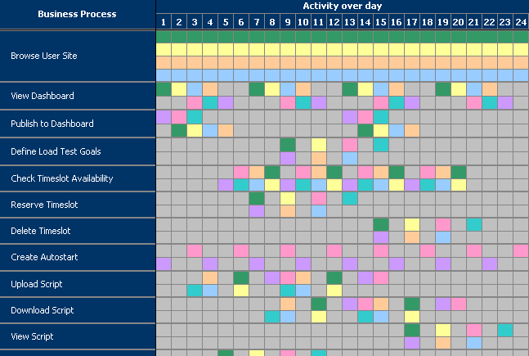
PC Business Activity Diagram

Slide 37
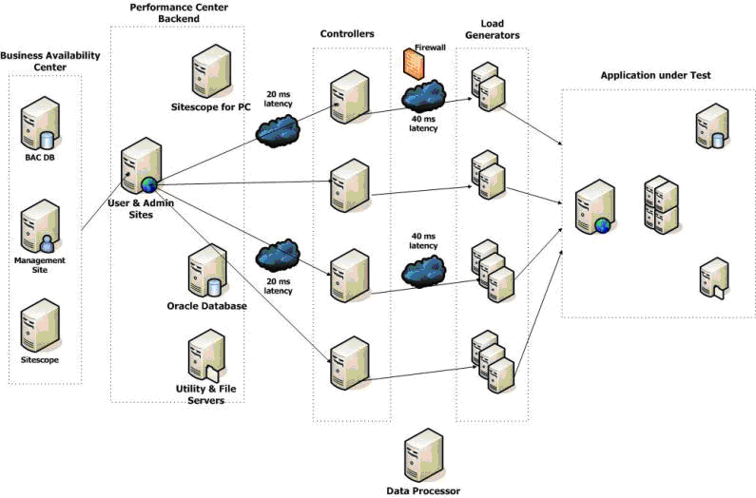
PC IronMan Setup

Slide 38
Monitors are a Must
Monitors Configuration
Web Server (User & Admin) | Maximum Connections
 | Bytes Total/sec
 | Current Connections
 | Errors/sec
 | Requests/sec
 | Requests Rejected
 | Requests Queued
 | Requests Execution Time
 | Request Wait Time
 | Errors During Script Run Time
 | Page Faults/sec
Process Measurements | % Processor time
 | Thread Count
 | Virtual bytes
 | Working Set
 | Handles Count
Processes | DLL Host , Session Object Activator (User Site)
 | Data Collection Agent (All machines)
 | Active Session, wlrun, online, Monitor app (Controller)
 | Maintenance Service, License, Auto Start (Utility)
 | Smart Disk Cleaner (File Server)
 | TBD (Data Processor)

Slide 39
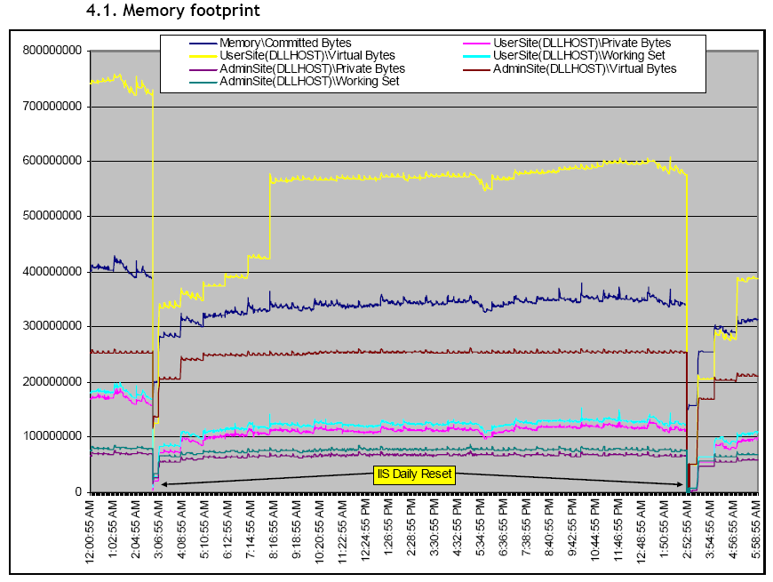
Memory Footprint

Slide 40
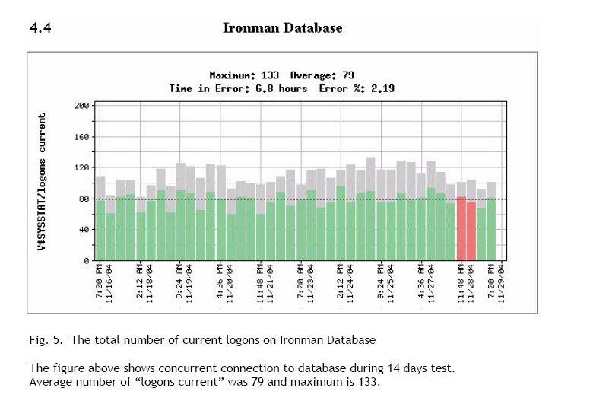
Database Logins

Slide 41
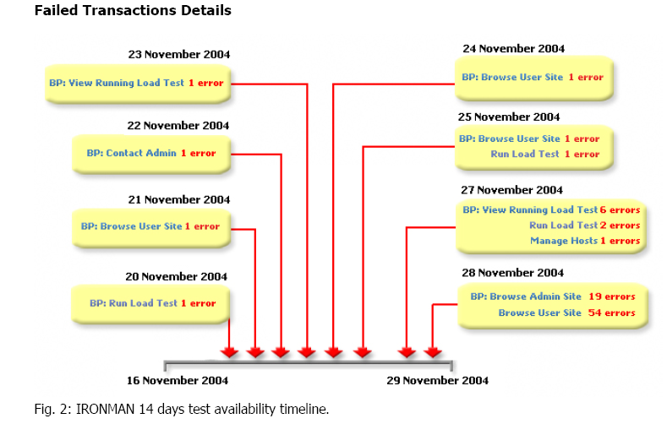
IronMan Timelines

Slide 42
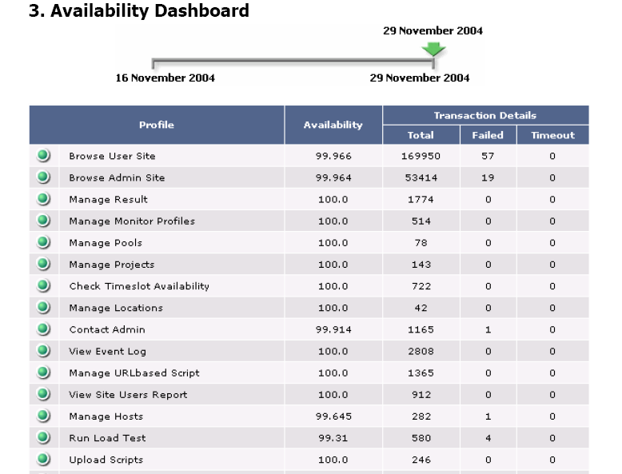
Availability and SLA Status

Slide 43
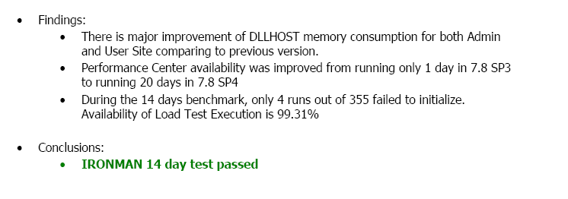
Summary Status

Slide 44

We operate a COE
Each R&D group works with the shared service team…
Project Plans and Progress
LOB Project Manager
Load Testing Projects
Service Estimates
Project
Mangers
Project
Managers
LOB Business Analyst
Unit Testing
Testing Results Data
Center
Manager
Performance
Engineers
Developer
Scripting and Training Support
Product A
Shared Services Team
Notes:
An effective process is not enough – close cooperation among the development, quality and performance organizations is necessary.
Quality, Performance and Development teams need to be integrated into an automated, cyclical process
Collaboration products are necessary to efficiently share data in order to resolve problems
Examples:
On the performance side, engineers responsible for testing application scalability first need to understand application requirements from a line of business point of view in order to build effective load tests – they need to cooperate with business managers and developers to make sure they test for how the application is expected to perform in production
Network and system architects need to collaborate with capacity planning engineers in order to ensure that the underlying system infrastructure has the right bandwidth and capacity to deal with peak application usage
Application support engineers who diagnose defects need to collaborate with the developers who rewrite the problem code

Slide 45
Our Org Chart
CoE Business Owner
Project Managers
Administrator
Performance Testers
Physical
Logical

Slide 46


